Slide 1
New Market Entry Strategies

Slide 2
Asia Pacific New Countries in the Pipeline

Slide 3
Why should I consider entering a new market in Asia Pacific Region?

Slide 4
Asia Pacific Unification
Opened up tremendous opportunity to build and sell into ALL countries in Asia Pacific Region with all BV and IBV accumulating into home country of the UFO to earn more residual income.

Slide 5
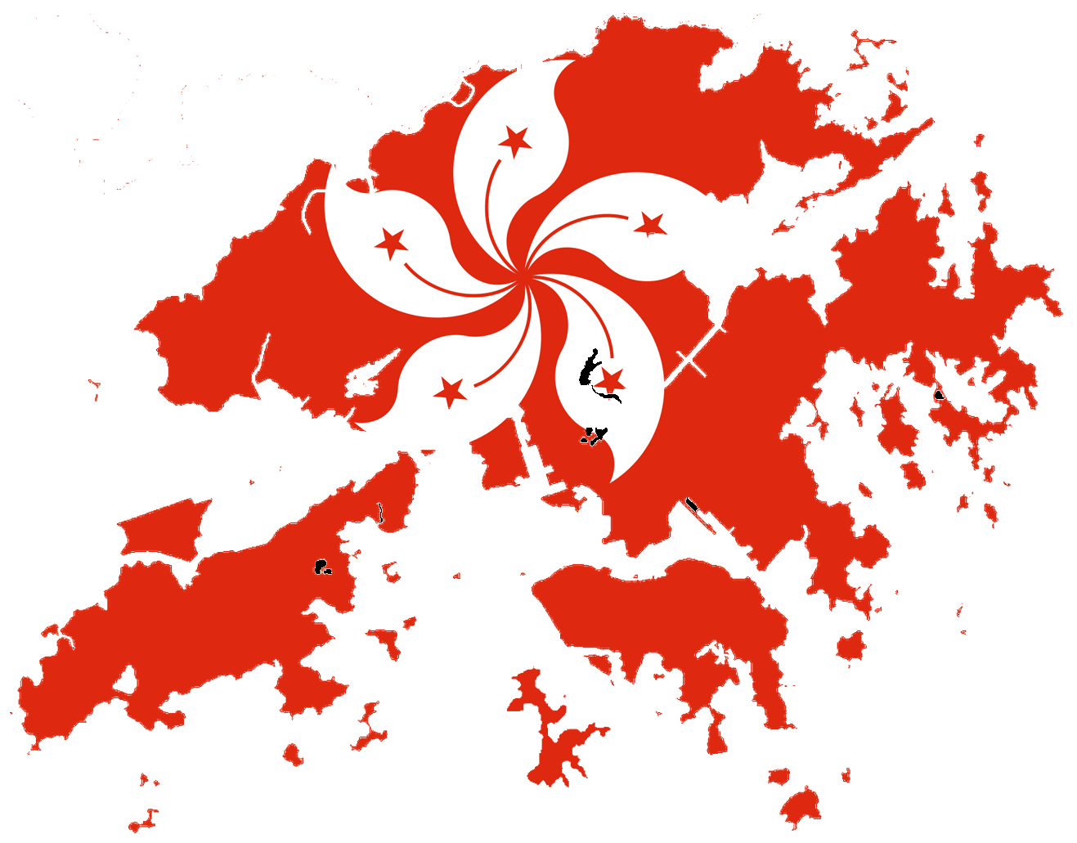
Asia Pacific Unification One Asia Pacific Commission Plan
TWO
LARGER
BV/IBV BANKs
All BV/ IBV flows up no matter what Asia Pacific country
sg1
sg2
sg3
sg1
tw1
sg2
sg3
tw2
tw3
hk1
tw1
hk2
hk3
tw2
tw3
hk1
au1
hk2
hk3
au2
au3

Slide 6
Assuming the Next Asia Pacific Market County
Nearly 14% of population engaged to Direct Selling
Contributed 3% of Global Direct Selling Revenue
Malaysia

Slide 7
Am I ready to enter a new market country?

Slide 8
Enter a New Market Country Alone
Be a gonow UFO
Be an experienced UFO who can operate the Unfranchise® business independently
Work locally and think globally

Slide 9
Enter a New Market Country As a Team
Be a team player
The leader of the team must be an experienced gonow UFO who at least completed one built-up BDC and is working toward completion of the second BDC

Slide 10
Before a New Market Country Opens
Understand the culture of the new market country
- Language, Religion, Social System, History,
Working Habit, Punctuality, etc.
Familiar with the geographical factors and transportation information of the target areas
It may take 3 to 6 months to get the understanding and familiarity from reading books, searching the internet and visiting the target areas the target area

Slide 11
Before a New Market Country Opens
Collect possibility/prospect list
- From team members, relatives, friends, social media, etc.
Use Global.Shop.com to introduce products to potential customers and business partners
Visit potential customers and business partners

Slide 12
Before a New Market Country Opens
Develop the Work Plan to enter a new market country
- scheduling, time commitment, financial resources, etc.
Develop the Supporting Plan for the home country organization
- scheduling, time commitment, leveraging, etc.
Measure, Monitor, Adjust and Control!

Slide 13
New Market Entry Strategies
Remote Prospecting/Invitation
Four C’s for Duplication: Counseling, Coring, Combinations and Pollination
Common Leg Placement
Leverage GMTSS

Slide 14
Remote Prospecting/Invitation
Telephone, Email, Skype, Gotomeeting.com/Gotowebnar.com, Facebook, Line, WeChat, etc.
The purpose is to make an appointment – keep conversation concise

Slide 15
Prospecting/Recruiting Tools
UnFranchise.com
MA Mobile Media app
ma & GMTSS tickets
Presentations
+ Information
SM Friend + Private Groups
Share Videos + audios
Video + Audio library or links
ma &
GMTSS tickets

Slide 16
Prospecting/Recruiting ToolS
About MA. pdf
Getting Started Guide
Flip Chart
SG.SHOP.COM
marketsingapore.com.sg
& Custom Web Sites

Slide 17
The Difference Between
Counseling & Coring is:
THE NUMBER
Of PEOPLE
What needs to be Duplicated?

Slide 18
Corings
Types of Coring’s
SA + Assessment
Product
Power referral networking + Cross pollination
Combinations
Basic 5
NUOT
GMTSS AND TICKETS
SA MASTER MEMBER/SABP
GOAL STATEMENT + ACTION PLAN
SHOWING MPCP
TYPE OF CORING DEPENDS ON WHAT THE
GROUP NEEDS TO DUPLICATE AT THE TIME
You
Coring
Coring
Coring
EVERY GROUP OR TEAM IS AT A DIFFERENT STAGE OF DEVELOPMENT

Slide 19
Combinations
Two or more groups in different legs attend the same HBP, UBP, Coring in the same area

Slide 20
CROSS-POLLINATION STRATEGY
Teams in one geographic area find and invite people in another geographic area to build with you or Senior Partners
Start by Doing It In Your Own State/Country
Notes:
20

Slide 21
CROSS-POLLINATION STRATEGY
Then Expand Nationwide/Regionwide
Notes:
21

Slide 22
The Key To
Leverage
Multiple Locations
principle
Combinations & Cross
Pollination

Slide 23
Combinations
The Ultimate Leverage
Work Three to Four Legs Per Night
Recruit, Train, & Retain All at the
same time
Plug People In
Credibility Multiplier
Cross Pollination

Slide 24
Common Leg Placement
Build a power line (life line) at a new market country by placing new people from this new market country at the common leg first

Slide 25
Global Meeting, Training and Seminar System (GMTSS)
A proven system of meetings, seminars and events that provide new and established UnFranchise® Owners with individual learning opportunities that contribute to standardised and effective training

Slide 26
After showing the plan (follow up)
After the UBP
During new business owner registration
Create a sense of urgency
During call workshops
Selling Tickets
(education)
Call stable and waiting

Slide 27
2017 ma World Conference at Miami, FL (Feb. 9-11, 2017)

Slide 28
Rewards for Entering New Market Countries
Realise your dream of financial independence and time freedom faster
Increase the profitability and stability of your existing organisation faster
Speed up the effectiveness and efficiency of training junior leaders

Slide 29
Rewards for Entering New Market Countries
Australia: From FVP to EFVP (S$45,000 - > S$56,250/4W)
Taiwan: From EFVP to SFVP (S$56,250 - > S$78,750/4W)
Hong Kong: From SFVP to FP (S$78,750 - > S$100,000/4W)
Singapore: From FP to IFP (S$100,000 - > S$125,000/4W)
If I can do it, so can you!

